Slide 1
Dental Partnering for Heart Health
Donna Norkoli | Health Planner Coordinator
District Health Department #10

Slide 2
Consortium Members
Notes:
This project was a success due to the commitment of the Consortium members.
Ferris State University partnered to provide public health students to assist with conducting heart age screenings. Family Health Care is a Federally Qualified Health Center in Lake County. Their medical center and dental clinic provided venues for screening, tracking, and referrals for our HISP participants. My community dental Centers in Mecosta County provided screening and referrals for HISP participants.
Spectrum Health provided place to refer HISP participants for blood pressure and diabetes case management and developed and implemented a weight management program for HISP participants .

Slide 3
Community Partners
Michigan State University Extension
Live Well Mecosta County Coalition
Lake County Roundtable
Lake County Food Council
Mecosta and Lake County Senior Centers
Big Rapids Farmers Market
Bread of Life Food Pantry – Lake County
Notes:
We also engaged diverse community partners to promote the program and offer additional opportunities for HISP participants to participate.
MSU provided virtual lifestyle change programs and Diabetes PATH,
Coalition partners promoted the program to their clients and community contacts.
Senior Centers provided venues for Heart Age Screenings and programming.
We provided Heart age screenings and educational materials at the Big Rapids Farmers Market and the Food Pantry in Lake County,

Slide 4
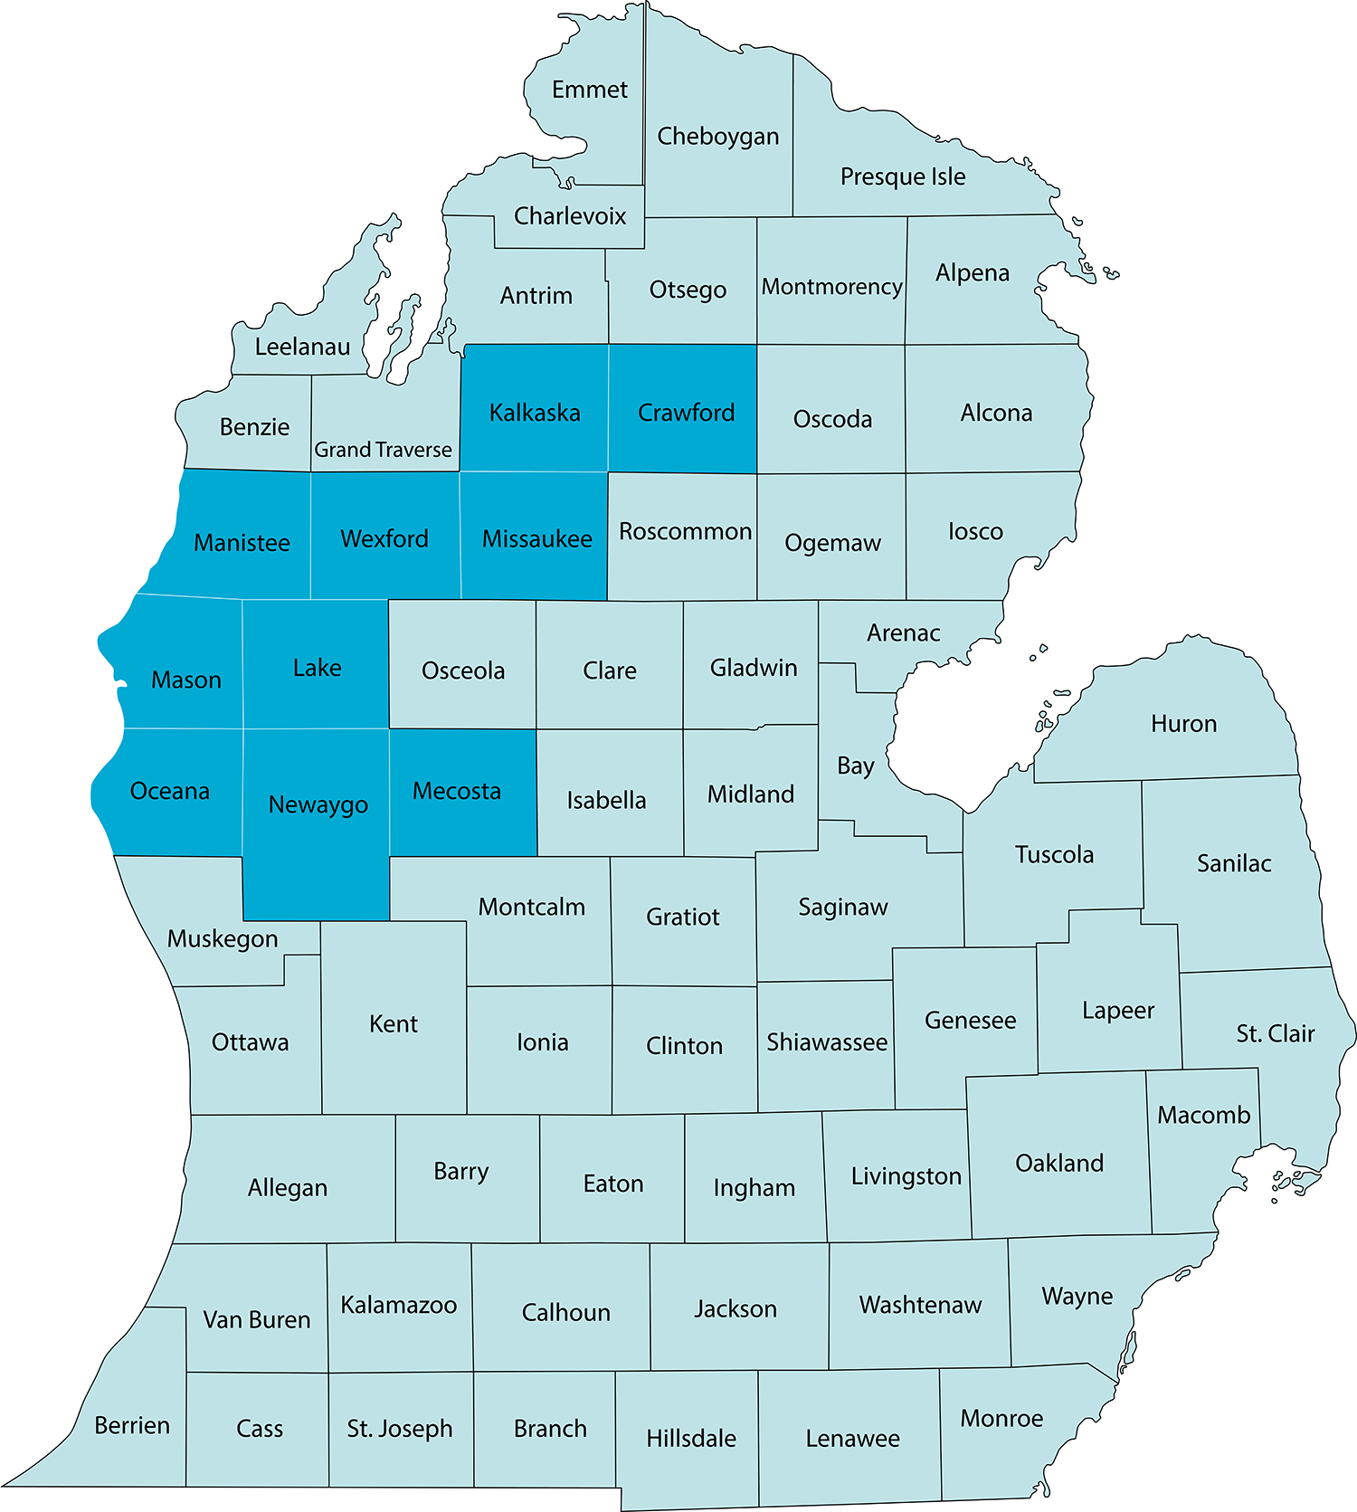
The “Dental Partnering for Heart Health Project” served adults ages 30 - 74 with no history of cardiovascular disease
The target service area included two rural counties within the DHD #10 jurisdiction - Mecosta County and Lake County
This project focused on connecting dental health providers, public health providers, and primary care providers to create programs and referral systems to reduce the risk of cardiovascular disease in their patients
The greatest need of the target population in the service area was lack of access to programs and services to reduce the risk factors of cardiovascular disease, such as smoking, unhealthy weight, high blood pressure, diabetes, and periodontal disease
Notes:
This is a map of the DHD#10 jurisdiction. The two target counties are Lake and Mecosta Counties.
31% of participants had high blood pressure.
19% had been diagnosed with diabetes,
79 had high BMIs
34% smoked cigarettes
41% were at risk for diabetes

Slide 5
How did we address this need?
Conducted Heart Age screenings of the target population using the CDC Heart Age Calculator
Provided referrals to appropriate services in each county based on CVD risk factors identified through use of the Calculator
Referring participants identified with risk factors for cardiovascular disease to case management and/or risk reduction programs and providing follow up by community health workers to assess for SDoH and navigate to resources
Created Community Clinical Linkages between healthcare providers, dental care providers and public health providers to address blood pressure case management, diabetes case management, weight management, tobacco cessation and diabetes prevention
Notes:
We had not planned on creating new programs. We wanted to implement systems change by creating community clinical linkages between dental providers and medical providers for blood pressure and diabetes case management and linkages between dental providers, medical providers and health department for tobacco cessation and diabetes prevention. We also wanted to improve linkages between medical providers and dental providers . We worked with providers to participate in the Smiles for Lie Continuing education module to screen for dental disease and provide referrals to dental clinics.

Slide 6
We found gaps in services
It was determined that there is a lack of resources or lack of awareness of resources available
Unhealthy weight was a risk factor for a significant percent of our program participants (80%), yet there were no programs available in the community to address weight management
Over 34% of our participants smoke cigarettes and there was no system of referrals for tobacco cessation from providers to the DHD#10 Tobacco Treatment Program
Over 40% were identified as at-risk for diabetes and there was no system of referrals for diabetes prevention from providers to the DHD#10 Diabetes Prevention Program
Notes:
There were existing programs available from DHD#10 – Tobacco Treatment Program and Diabetes Prevention Program but we were not getting many referrals. The linkages with the dental clinics and medical providers through this project created a great referral system. Previously tobacco cessation referrals went to the State Quitline. People were more receptive having a local connection.
Since so many participants were struggling to manage their weight we soon found there were no good resources for support and education, Spectrum Helth system stepped up and created a program that provided education, hands on learning and social support. Some comments from participants included:
“I enjoyed being able to discuss questions/answers privately with the RD. It was an incentive to do well.”
“Connecting with the health coach weekly helped me focus more on my goals and what I can accomplish.”

Slide 7
Tobacco Cessation Systems Change
Creating Systems Change
Assessing Referral System & Workflow
Created systems change for tobacco cessation in the My Community Dental Centers and the Baldwin Family Health Care dental clinic
Assessed current tobacco cessation referral system and workflow
Aligning Protocols & Practices
Updating Referral Process
Recommended health systems changes to align protocols and practices for treating tobacco use and dependence with the Clinical Practice Guideline for Treating Tobacco Use and Dependence
Dental Clinics made changes to facilitate referrals to the District Health Department #10 Tobacco Dependence Treatment Program and trained Tobacco Treatment Specialists
Notes:
The assessment provided insight on how they could improve their practices for helping patients quit smoking.

Slide 8
Tobacco Dependence Treatment Process Workflow Assessment Tool
Check off items below that are included in your organization’s existing policies and protocols for tobacco dependence treatment
Identify and assign staff to implement each component of the U.S. Public Health Service Clinical Guideline for Treating Tobacco Use and Dependence
Designated staff follow-up with patients at a determined interval to assess patients’ progress with quit attempt and provide further resources, as necessary
Every patient is asked about any and all current and past tobacco use, including electronic nicotine delivery devices, at every visit
Every patient is asked about exposure to secondhand smoke
Record tobacco use status (current, former, never) in the patient’s record
Patient who previously used tobacco has quit date and method documented in the patient’s record
Once a tobacco user is identified, a trigger is in place to alert the health care provider to address tobacco use and provide treatment
Health care professional strongly advises every patient who uses tobacco to quit
Once a tobacco user is identified and advised to quit, the patient’s willingness to quit is assessed
Referrals are made to evidence-based tobacco dependence treatment resources
Designated staff follow-up with patients at a determined interval to assess patients’ progress with quit attempt and provide further resources as necessary
Notes:
This is an example of some of the assessment questions.
Some of the improvements made were in documentation:
Patient who uses tobacco has quit date and method documented in the patient’s r
record.
Follow-up made to the patient regarding quit date, future appointments, etc.
DHD#10 referral forms were integrated into their workflow.
BFHC dental clinic created a fillable referral form for all of their clinics in their EHR.

Slide 9
Fit 4 U Weight Management
10 Fit 4 U programs with multiple sessions were completed from July 2019 to April 30, 2022
132 participants initially signed up for FIT 4 U and completed a pre-assessment.
64 participants completed both a pre- and post-assessment for the program.
Of the 64 participants completing program, 45 participants met their goals. Goals included decreasing weight, decreasing BMI, and decreasing body fat percentage.
Average participant weight reduced by 4.2 pounds
Average participant BMI reduced by 0.76
Average participant daily fruit consumption increased by 1.16 servings
Average participant daily vegetable consumption increased by 1.63 servings
Average participant weekly activity minutes increased by 35.02 minutes
Average participant estimates of confidence to sustain healthy changes on a scale of 1-10 (10 being best) increased by 0.89
Average participant estimates of how informed of healthy behaviors on a scale of 1-10 (10 being best) increased by 1.59

Slide 10
Impact on Health Outcomes
Number of participants successfully enrolled in Live Well for Your Heart | 577
Number of participants who remained active with heart age tracked over time | 399 (69%)
Average % improvement in Heart Age for participants tracked over time | 12.3%
Participants who achieved a 5% or greater improvement in Heart Age by the end of the project | 87 Total 22% of participants tracked over time
Number participants with improvements to their BMI by the end of the project | 173 (43%)
Number of participants with improvements to their Blood Pressure by the end of the project | 152 (38%)
Number of participants tracked over time with a diagnosis of Diabetes | 103 (26%)
Number of participants with a diagnosis of diabetes that improved their HbA1c control by the end of the project | 21 participants that we know of improved their A1c
Number of participants tracked over time identified as smoking cigarettes at start | 145 (36%)
Number of participants identified as smoking cigarettes at start who quit smoking by the end of the project | 27 (19%)

Slide 11
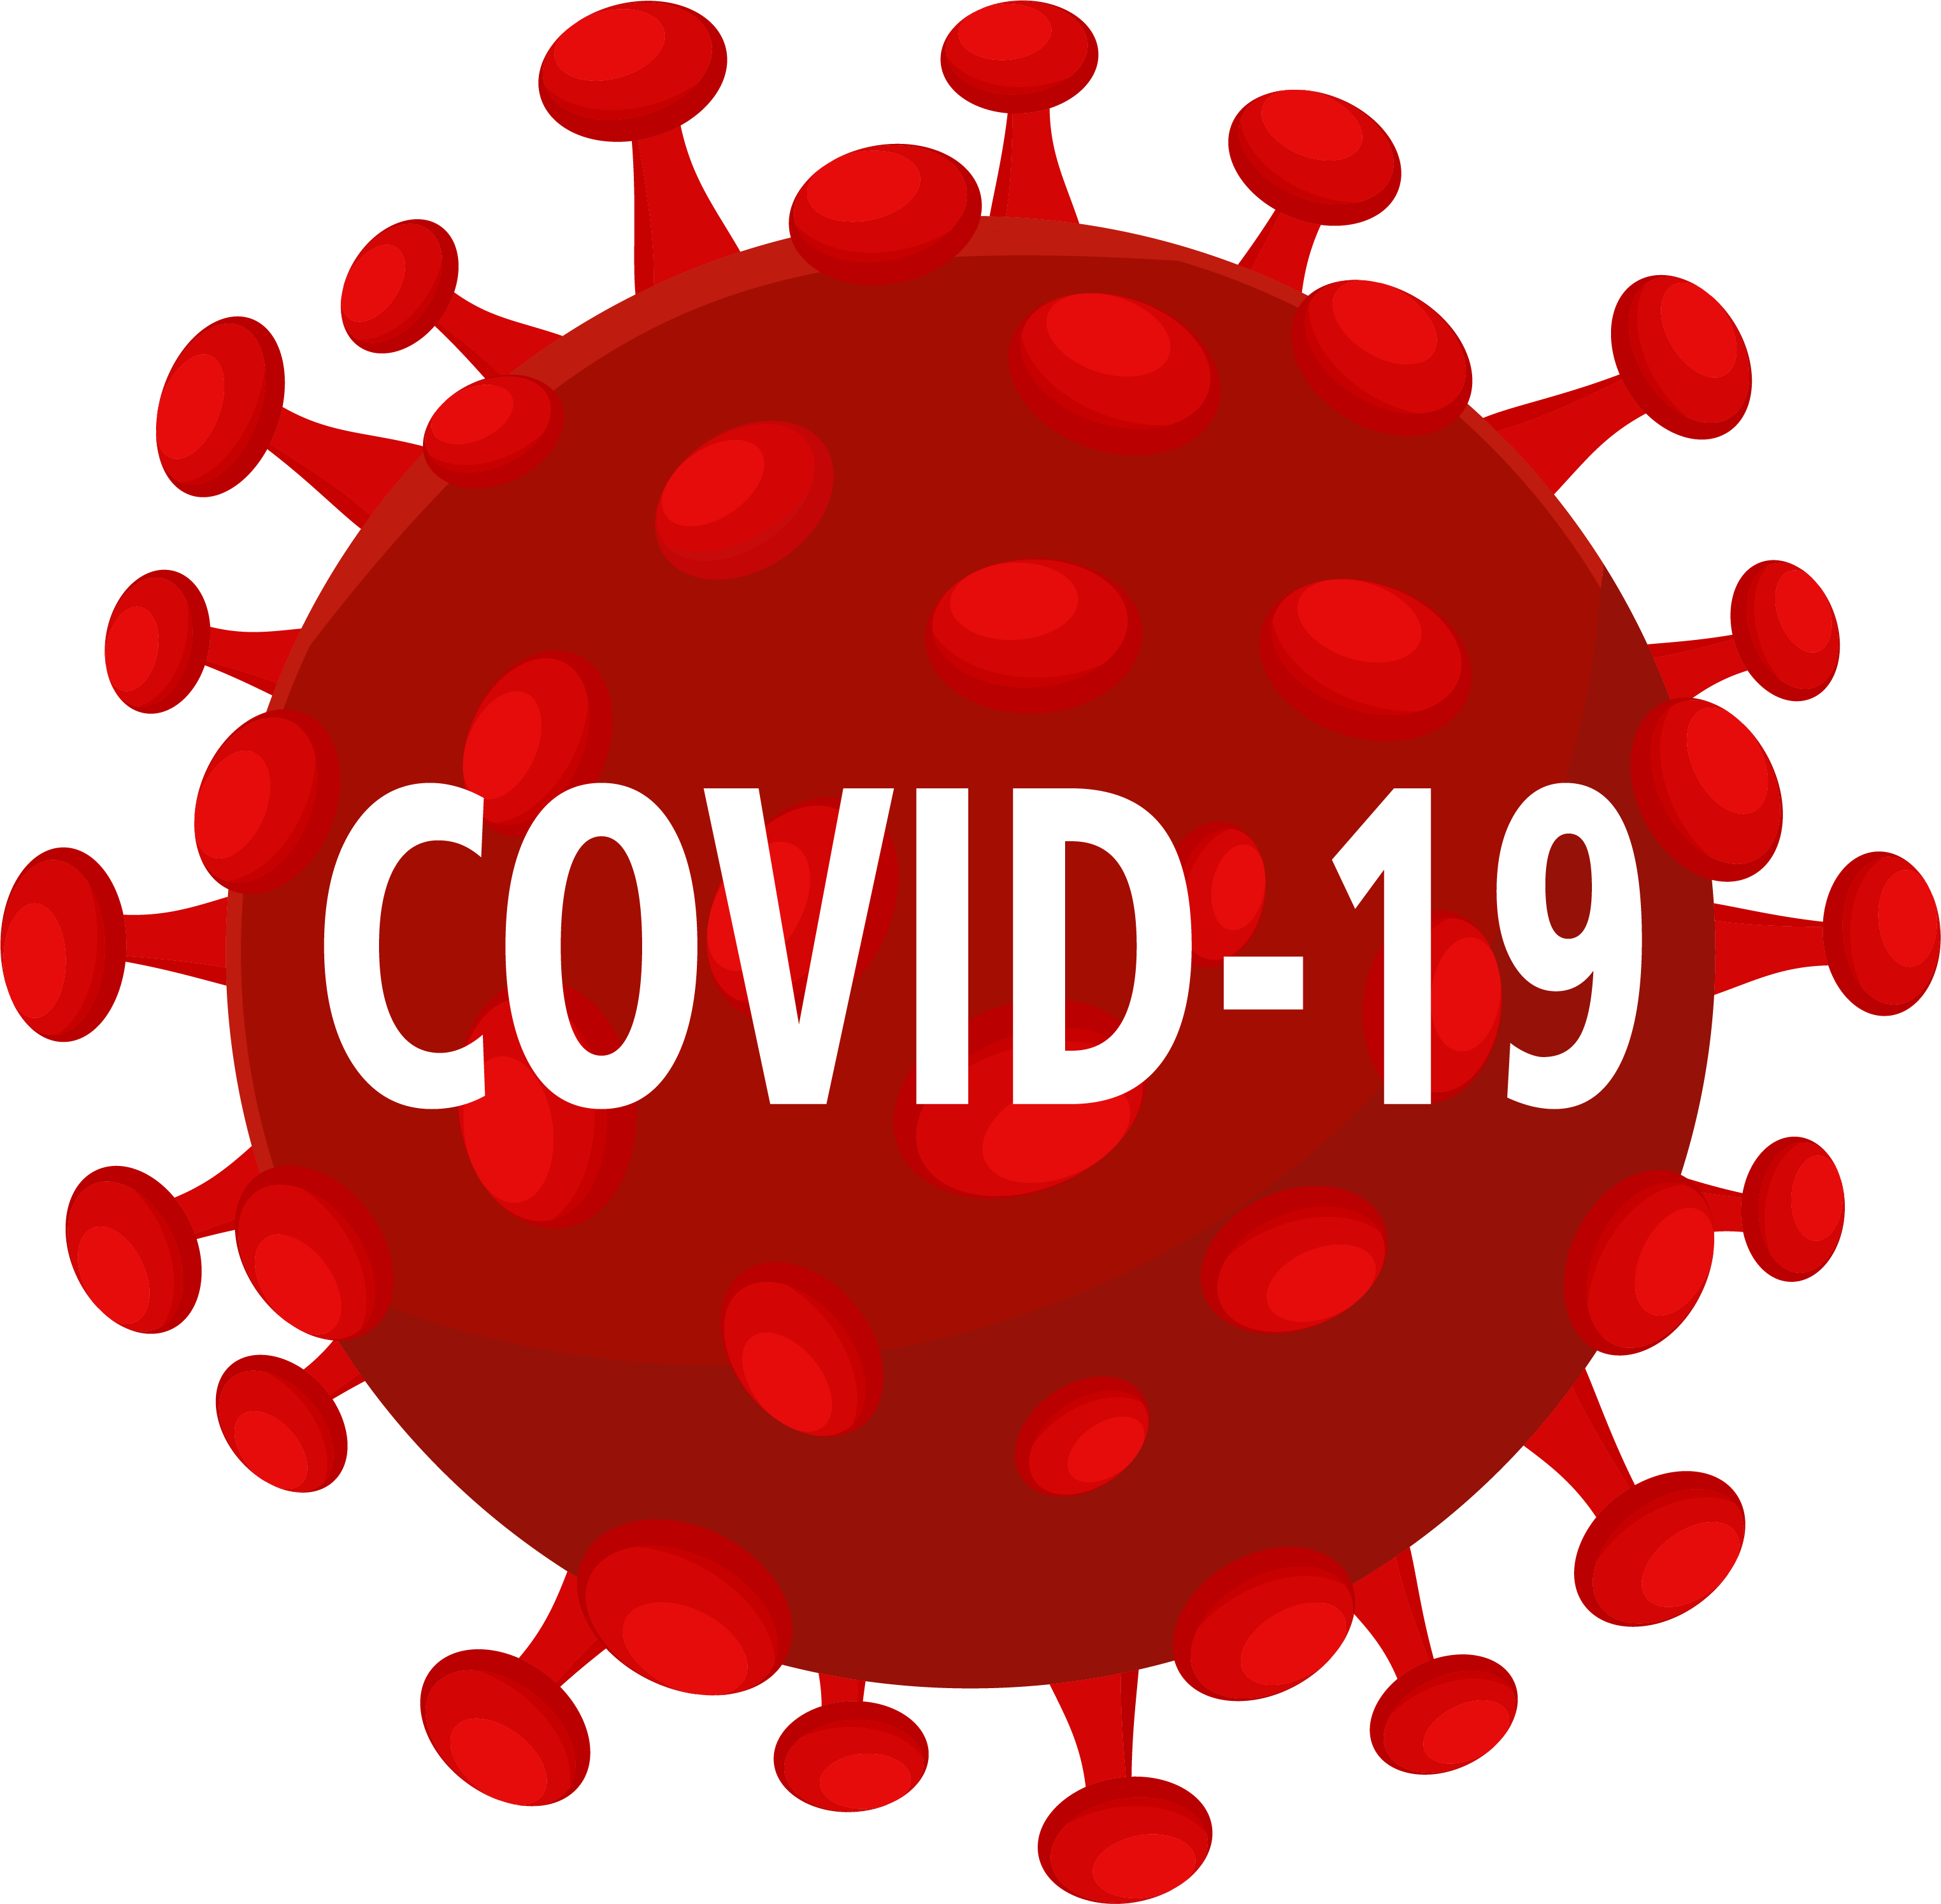
Challenges, Successes, and Lessons Learned
The year 2 and 3 screening period was largely impeded by the ongoing COVID-19 pandemic
Dental clinics shut down
Family Health Care Staff and DHD#10 staff were assigned to covid-related activities
Fit 4 U went virtual – Broadband access was a significant barrier
People did not want to come to health care facilities for non-essential services and some sites were closed to non-essential services
When dental clinics reopened there was a severe workforce shortage
Notes:
The dental clinics shut down in March 2020 so that stopped our rescreening for year three at the dental clinic sites.
Staff at all sites and DHD#10 were assigned to covid-19 duties so most of the work on this project was put on hold.
Fit 4 U had to go virtual This was a big problem for Lake County participants. 0.7% of homes in Lake County have broadband as compared to 85% in the State of Michigan.
Participation from our Lake County referrals went to 0.
When the dental clinics reopened there was a huge staff shortage. My Community Dental Centers had to drop out of the project due to the lack of staff to take on any extra duties.

Slide 12
Workarounds to meet the challenges
Baldwin Family Health Care (BFHC) switched to conducting screenings at the medical provider appointments
Some of the heart age screenings were conducted by phone
We offered incentives for participation
We increased communications by social media, email and regular mailings – Facebook boosts, program announcements and quarterly newsletters
A survey was created to determine barriers and challenges to participation in CVD risk reduction and lifestyle behavioral change programs
A goal setting sheet was created to encourage participant buy-in and commitment to lifestyle change
Notes:
It was easier to track participants through their medical provider visits than at their dental visits during covid.
In Mecosta County, due to MCDC not being able to continue screenings, DHD#10 staff called participants and they either came to the health department for the screening or were screened over the phone. We offered gas cards as an incentive to come in person for the screening.
Due to being year 3 and into year 4 of the projectwe felt a great need to keep participants engaged. We increased email notices of program opportunities, social media posts, mailings, and quarterly newsletters.
We developed a survey to assess satisfaction with the program and get feedback on needs of participants.
The goal setting sheet was an effort to encourage commitment to realistic, achievable lifestyle changes and also to assess barriers to making change and strengths to help them achieve their goals. It was very eye opening to read some of the challenges participants were facing and affirmed the need to focus on SDoH.

Slide 13
Successes
42%
72%
64
42% (154) of participants rescreened in Year 2 and/or Year 3 lowered their 10-year risk of heart attack or stroke from their initial Year 1 screening
72% (63) of participants with high blood pressure readings in Year 1 had normal blood pressure readings when rescreened
participants completed the Fit 4 U weight management program conducted by Spectrum Health Big Rapids Hospital and now have a weight loss plan
Strengthened relationships with partners greatly enhanced our reach in the community and created community buy in and support.
Notes:
Most importantly, our strong partnerships will continue by carrying on implementation of strategies to promote healthy lifestyles and reduce rates of cardiovascular disease.
We are partnering with Spectrum Health to expand our Community Connections – community clinical linkages program to an adjacent county. We are providing the CHW and setting up referral systems in this county. We have expanded our Consortium through a HRSA Rural Health Network Planning Grant to include additional partners and have developed a Strategic Plan to increase collective impact through systems change and build a shared understanding of health equity needs in the region, including gathering resident voice.

Slide 14
Lessons Learned
People are not always motivated to make lifestyle changes – How do you reach people where they are?
Tracking a large cohort for the entire three years and into year 4 was not easy.
Linking participants to other existing programs was a huge success!
Notes:
Consortium members were optimistic that since we had programs to reduce cardiovascular disease risk factors in place, it was simply a matter of referring participants to the appropriate program and we would see results in reduction in risk for heart disease. What we learned was, it was not that simple. Just referring someone to a program did not mean the participant would actually participate in the program. Consortium members had to design new strategies to engage participants in CVD risk reduction programs. We provided a variety of incentives to reduce barriers and encourage participation. These included gas cards for transportation, fruit and vegetable vouchers for the Fit 4 U and Diabetes Prevention Program, healthy cookbooks, pedometers, drawings for wellness kits, and free nicotine replacement therapy for participants enrolling in tobacco cessation services.
We decided to limit community screenings and screen participants who were medical or dental patients at My Community Dental Centers and Baldwin Family Health Care. A smaller cohort of people who engaged with each other for social support might have increased success with enrolling participants in programs, such as tobacco cessation, weight management, Diabetes PATH, and Diabetes Prevention. We are replicating this program, currently, in two additional counties and we are screening a smaller number of eligible adults and focusing more on follow up and engagement in lifestyle change programs.
The project was successful in utilizing a Community Health Worker to enroll participants in the Community Connections Hub program to screen them for social determinants of health and connect them to needed resources in the community. This was a valuable addition to our project.

Slide 15
Next Steps and Sustainability
The Fit 4 U weight management program is now integrated into the 2022 Spectrum Health Community Health Improvement Plan
Tobacco Dependence Treatment Program and Community Clinical Linkages
Strengthened partnerships
Notes:
The Dental Partnering for Heart Health Project has led to development of a strong and sustainable Consortium. Partners agreed that relationships between project partners and Consortium members have been strengthened and these partnerships are important and sustainable.
Multi-sector systems have been put in place for referrals to tobacco cessation, the Diabetes Prevention Program, weight management, and case management for blood pressure and diabetes.
The Fit 4 U weight management program will continue and fills a need that is lacking in our project area. Seventy-nine percent of our participants have BMI scores outside of the normal range for BMI.
A 13 county community Health needs assessment was completed in partnership with DHD10, 6 other health departs and three hospital systems. After the strategic issues were prioritized Spectrum Health included the Fit 4 U program as a strategy to address the need to reduce chronic disease rates in our region.
New programs to address the need for reducing CVD risk factors have been developed and will be sustainable. Baldwin Family Health Care is now implementing classes for diabetes management with a RN Case Manager. The Tobacco Health Systems change activities implemented with the dental clinics have led to a partnership with District Health Department #10 to implement health systems changes to align protocols and practices for treating tobacco use and dependence with the Clinical Practice Guideline for Treating Tobacco Use and Dependence. Dental clinic staff are now asking patients at every visit about their tobacco use status, assessing the patient’s readiness to quit and referring patients to the DHD#10 Tobacco Dependence Treatment Program. DHD#10 staff are providing the follow up and documentation of quit attempts and successful quit rates.

Slide 16
Thank You!
Contact information:
Donna Norkoli
dnorkoli@dhd10.org
Questions ?
This project is supported by the Health Resources and Services Administration (HRSA) of the U.S. Department of Health and Human Services (HHS) under grant number D04RH31633 Rural Health Care Services Outreach Grant Program.

